Slide 1

Memory in Agentic AI – Part 2
Vector Databases & Agentic Memory Architecture

Slide 2
Quick Recap from Part 1
Working memory = context window Attention acts like temporary memory Buffers store session history All of this is temporary
Problem:
Nothing persists after session ends.

Slide 3
The Big Question
If LLM memory is temporary…
How do we build:
Persistent knowledge?
Document recall?
Cross-session memory?
Multi-agent shared memory?
Answer:
External Memory Systems

Slide 4
What Is External Memory?
Memory stored outside the model.
Examples:
Databases
Vector databases
Task logs
Knowledge bases
Agent reflection memory
This is persistent.

Slide 5
Why LLMs Need External Memory
LLMs cannot:
Store large document collections
Remember previous sessions
Search over thousands of files
Track task history
So we externalize memory.

Slide 6
What Is a Vector Database?
A vector database stores:
Text → converted into embeddings (vectors)
Each entry contains:
Vector representation
Original text chunk
Metadata (file name, page number, etc.)
It enables:
Semantic search.

Slide 7
How Vector Memory Works
Convert documents into embeddings
Store in vector DB
Convert query into embedding
Compare similarity
Retrieve top_k results

Slide 8
Retrieval Is Memory Recall
In our code:
private_docs_retriever.invoke(query)
This is:
Memory recall from semantic memory.

Slide 9
What Is Stored in Vector DB?
Each record includes:
Embedding vector
Text chunk
Metadata (source, page, score)
Possibly timestamp
This is structured memory.

Slide 10
Semantic vs Episodic Memory
Semantic Memory:
Facts
Documents
Knowledge
RAG content
Episodic Memory:
Past actions
Failed refinements
Task history
Evaluation results
Agents need both.

Slide 11
Where Semantic Memory Sits
User ↓ Planner ↓ Retriever (Vector DB) ↓ Evidence ↓ LLM
Vector DB is external semantic memory.

Slide 12
Episodic Memory in Agents
Imagine our agent:
Planner → Retrieve → Critic → Refine
What if it stores:
Which queries failed
Which refinements worked
Confidence scores
User corrections
That becomes episodic memory.
Now agent improves over time.

Slide 13
Agent Memory Loop
Query ↓ Retrieve ↓ Evaluate ↓ Store outcome ↓ Adjust strategy
This creates self-improving agents.

Slide 14
Hybrid Memory Architecture
Complete memory system:
Working Memory + Session Memory + Vector Semantic Memory + Episodic Task Memory
All together → Agentic AI

Slide 15
Design Decisions in Memory Systems
When building vector memory, we must decide:
Chunk size
Overlap
Embedding model
Similarity metric
top_k value
Score threshold
Memory pruning
Memory design affects reasoning quality.

Slide 16
Risks of External Memory
External memory introduces risks:
Retrieval hallucination
Stale information
Irrelevant top_k results
Over-retrieval
Embedding drift
Memory must be managed carefully.

Slide 17
Context Poisoning
Context poisoning occurs when incorrect or malicious information enters the external knowledge base, and the LLM treats it as trusted evidence.
Example
Suppose a document in the vector database contains:
“The capital of Australia is Sydney.”
When retrieved, the LLM will answer:
“Sydney is the capital of Australia.”
Even though the correct answer is Canberra.
Why this happens
LLMs assume retrieved documents are reliable.
Real-world risk
• Wikipedia vandalism • malicious documents in company knowledge bases • adversarial prompt injections in RAG systems
Mitigation
• document verification • trusted sources • ranking models • retrieval filtering

Slide 18
Retrieval Collapse
Retrieval collapse happens when the retriever repeatedly returns the same document or similar chunks, even when the query changes.
Example
User queries:
“Explain reinforcement learning.”
“What is Q-learning?”
“What is policy gradient?”
Retriever returns the same RL introduction document every time.
Why this happens
• embedding similarity clusters around dominant documents • dataset imbalance • poor chunking
Result
The system loses information diversity, and answers become repetitive.
Mitigation
• Maximal Marginal Relevance (MMR) • diversity-based retrieval • better chunking strategies

Slide 19
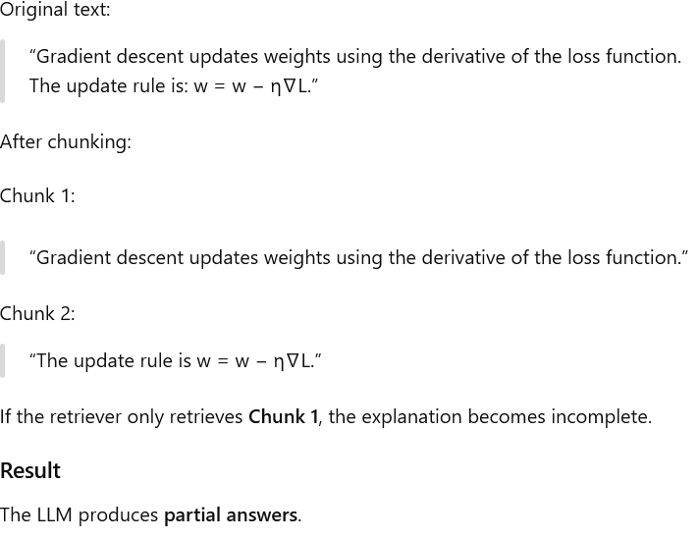
Chunk Boundary Problem
When documents are split into chunks for vector storage, important information may be divided across chunks.
Mitigation
• overlapping chunks • semantic chunking • hierarchical retrieval

Slide 20
Semantic Dilution
Semantic dilution occurs when too many documents are retrieved, causing the important context to get buried.
Example
Query:
“Explain attention mechanism in transformers.”
Retrieved documents:
Attention mechanism
Transformers architecture
NLP overview
Machine learning basics
AI history
The useful information becomes diluted by unrelated context.
Result
The LLM generates generic or vague answers instead of precise ones.
Mitigation
• reduce top_k • reranking models • relevance scoring

Slide 21
Memory in our Agentic RAG System
In our controller:
Planner → Retriever → Critic → Refine → Final
Vector DB = semantic memory
Buffer = session memory
Context window = working memory
If we add log storage → episodic memory
Now it becomes a true agent.

Slide 22
Memory Hierarchy
Layer 1: Attention (working memory)
Layer 2: Buffers (session memory)
Layer 3: Vector DB (semantic memory)
Layer 4: Logs & reflection (episodic memory)
This is the architecture of modern agentic AI.

